Slide 1
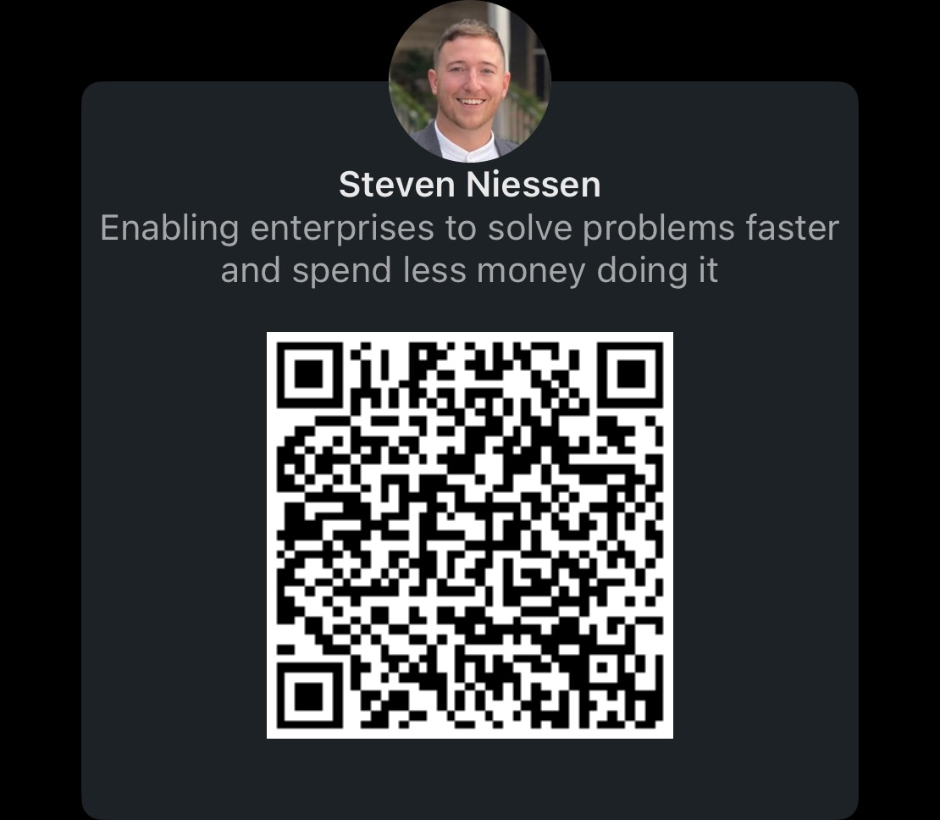
OTel: The Future of Observability
Steven Niessen
https://www.linkedin.com/in/stevenniessen/

Slide 2
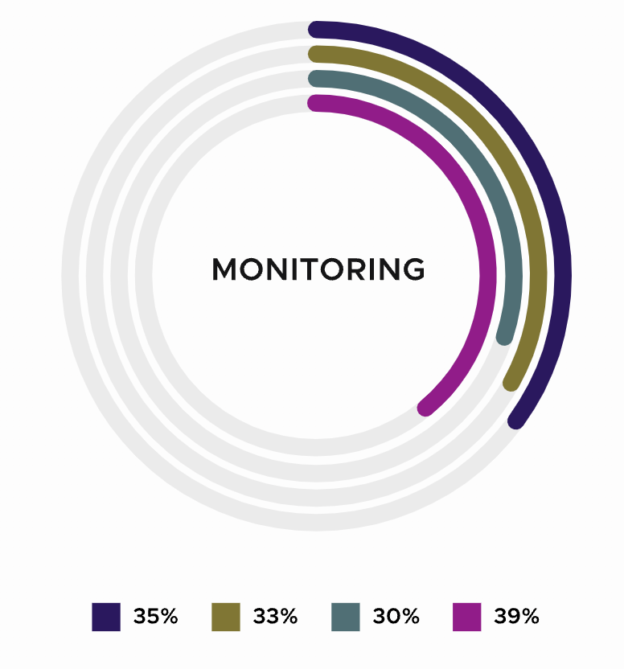


Why OTel: Monitoring and Observability are the top challenges in Kubernetes
100%
75%
82%
74%
50%
64%
48%
25%
2021
2022
2023
2024
% Of Companies That Take More Than 60 Minutes To Resolve An Incident In Distributed K8s Environments
Source: CNCF Annual Survey
Source: https://www.cncf.io/reports/cncf-annual-survey-2023/

Slide 3
What is
Observability?
Notes:
Logs
Metrics
Tracing
2nd biggest cost center in IT in the fortune 500

Slide 4
Why is it so important to your business?

Slide 5

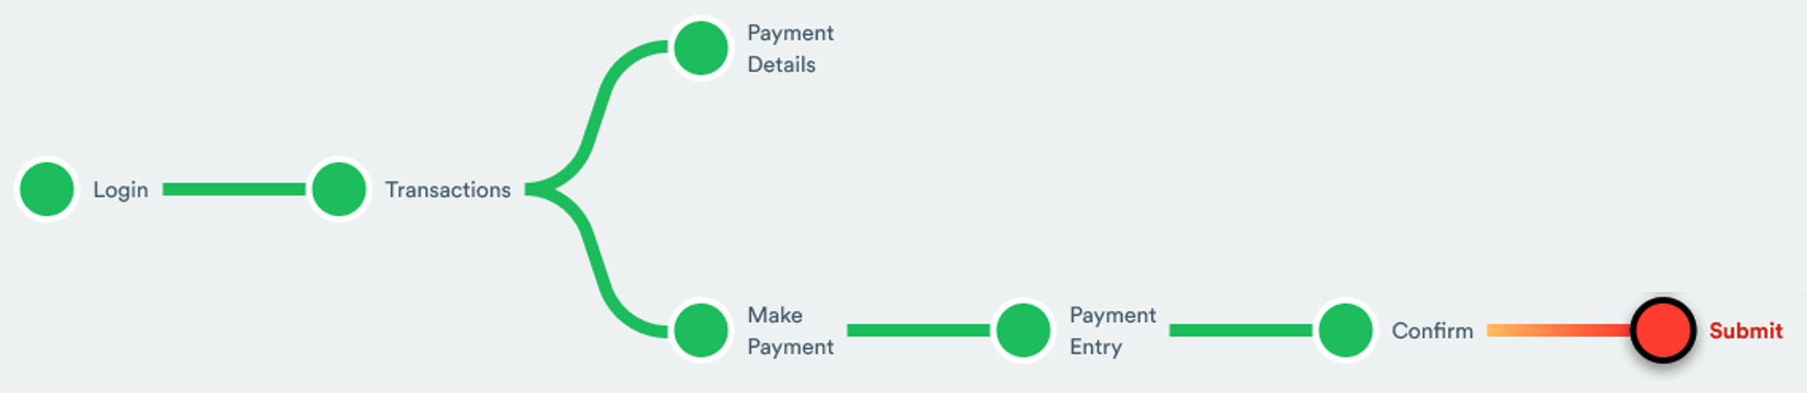
Observability: Customer Journey
Executive
Customer
Start Troubleshooting By Understanding What The User Is Trying To Do.

Slide 6


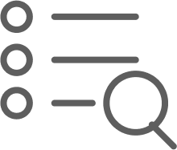

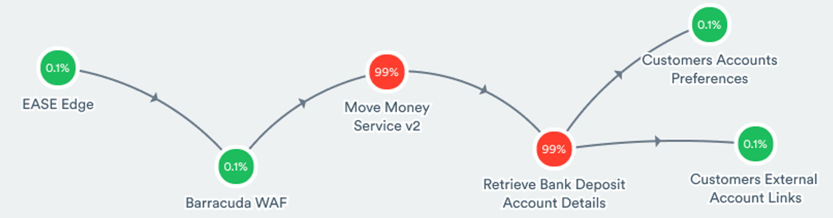
Drill To Related Microservices
View Service Map
View Related Metrics
View Related Logs
Executive
Customer
SRE
Services
Drill Without Losing Context - Just See Services For “Submit”
Reduce Dependence On “Experts”

Slide 7

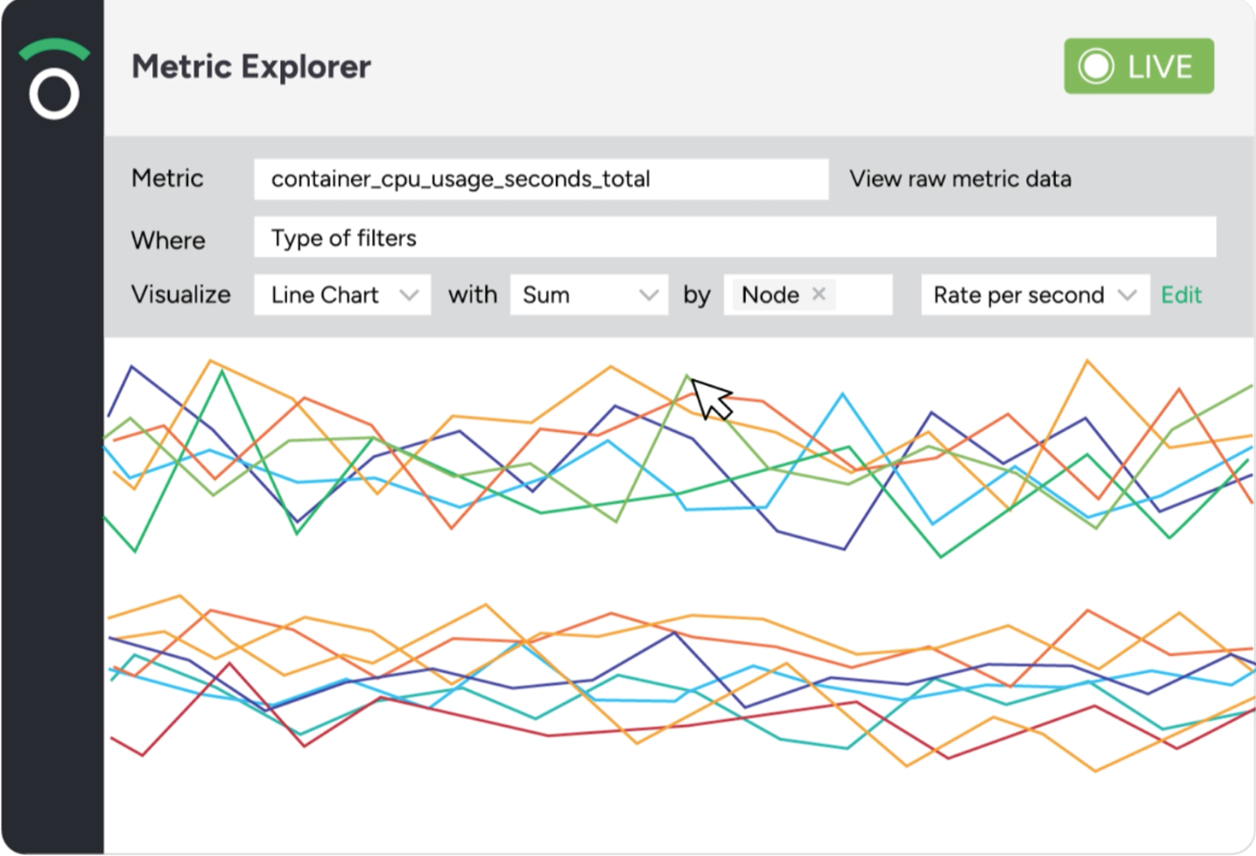
Drill To Related Metrics
Executive
Customer
View Journey Map
View Related Metrics
99%
View Related Logs
SRE
Services
Metrics
App Dev
Telemetry

Slide 8
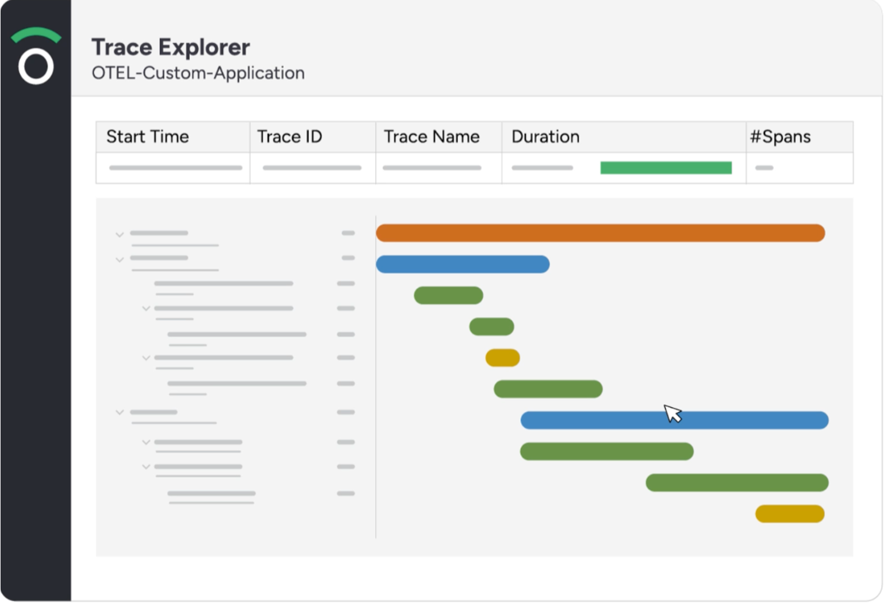
Pivot From Metrics To Traces
Executive
Customer
SRE
Services
View Service Map
Metrics
Traces
View Related Logs
App Dev
View Related Traces
Telemetry

Slide 9
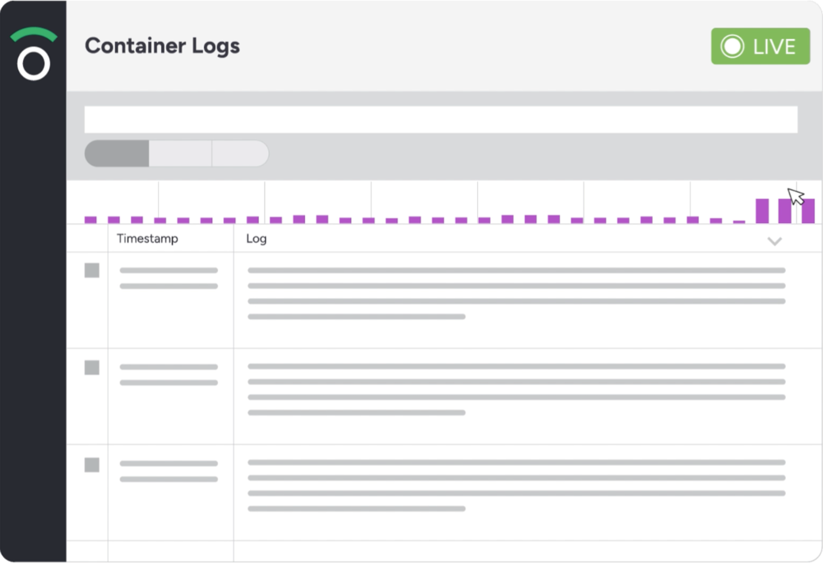
Pivot From Traces To Logs
Executive
Customer
SRE
View Service Map
Services
View Related Logs
Metrics
View Related Metrics
Logs
Traces
App Dev
Telemetry

Slide 10
Observability = Drill & Pivot With Context
Executive
Customer
Drill
SRE
Services
Pivot
App Dev
Telemetry

Slide 11




Why OTel Now: The Game Has Changed
Static Infrastructure
Elastic Infrastructure
Fixed Capacity
Unlimited Capacity
On-Premises
Cloud
10s-100s Of Servers
100s-1000s Of Servers
Low Data Volumes
High Data Volumes
Monolithic
Microservices
1-2 Releases Per Year
1-200 Releases Per Year
Little Change
Lots Of Change
Waterfall
CI/CD

Slide 12


Slide 13
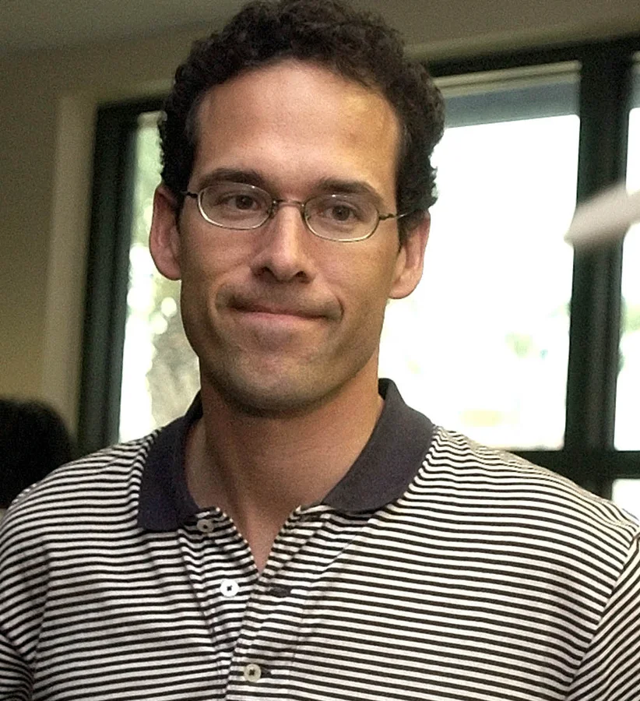
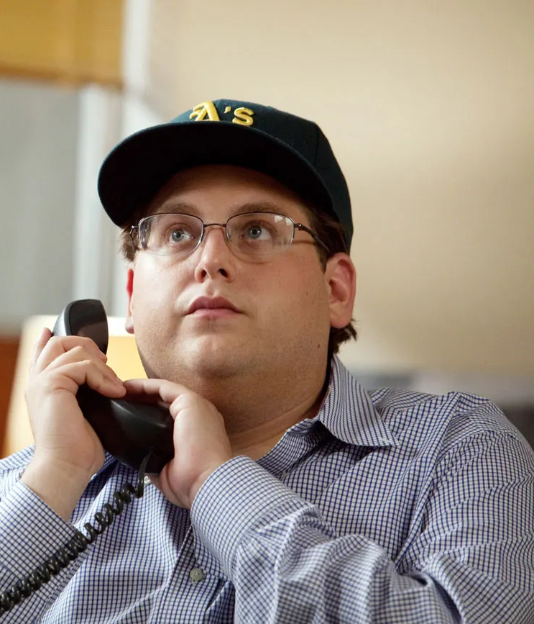
Notes:
“Peter Brand” aka Paul DePodesta, played baseball at Harvard with a degree in economics

Slide 14
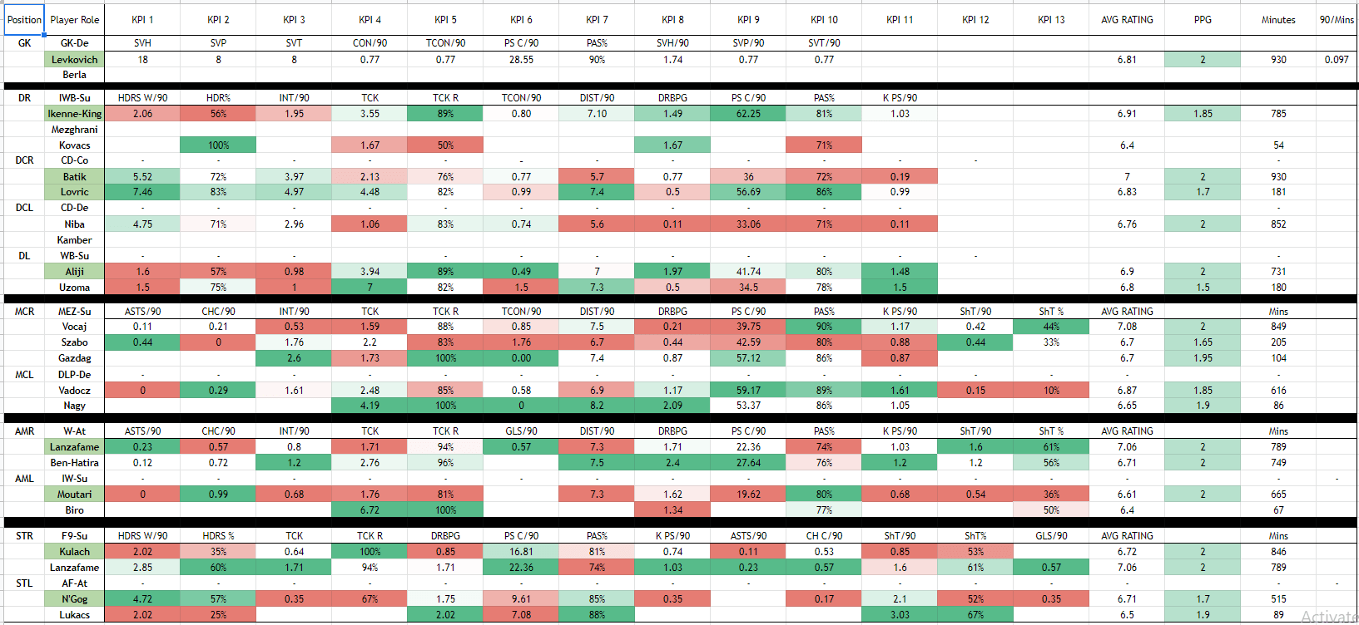
2002
Notes:
Splunk was created in 2003
The problem in that day was collection of data which sparked the industries focus on building robust data collectors

Slide 15
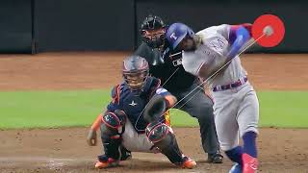
22 Years Later
Notes:
What’s changed?
Exponentially more variables
No longer cut and dry

Slide 16
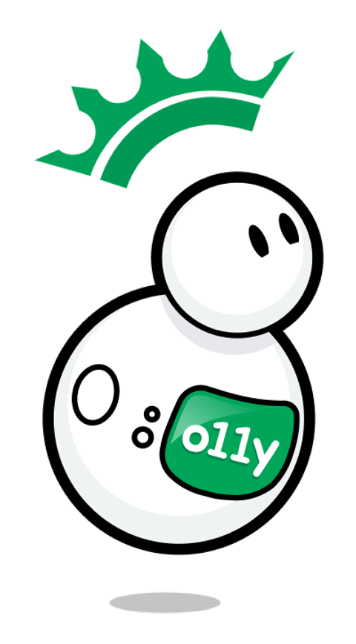
Promise of Observability
Your Online Service Is Your Business, Customer Experience Is King
Observability Is Required To Drive A Great Customer Experience

Slide 17

Observability w/o OTel
What’s getting in the way: Multi-format data, multi-agent collection, vendor dependency = Operational inefficiency, higher MTTR, less time spent on IP
Business Impact: Lower CSAT, customer churn, OpEx ↑ Innovation ↓

Slide 18
How OpenTelemetry Helps
Data Formatting
Tooling Simplification
Vendor Neutrality
Yeahhhhh, these means we are going back to the white board
Notes:
Logs
Metrics
Tracing
2nd biggest cost center in IT in the fortune 500

Slide 19
Data Formatting:
Save time, find context & correlations faster
Tooling Simplification:
One agent to rule them all

Slide 20
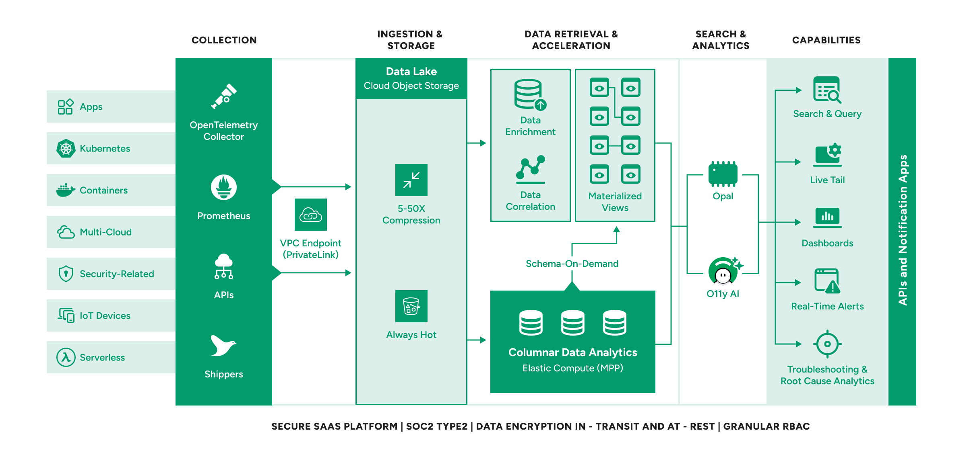

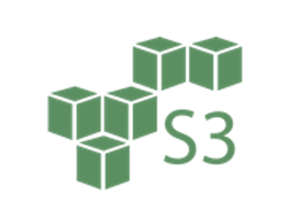

Modern Means Open Standards
One agent, one format for collection and processing
Apps
Collection
Kubernetes
Containers
Logs, Metrics, Traces & Much More
Multi-Cloud
Data Lake
Security
S3 Object Store, Iceberg Format
IoT Devices
Serverless
Notes:
Lets drill into Storage.
The monitoring cloud has a legacy architecture. It was never designed for cheap cloud storage.
It requires high performance storage, tightly linked to compute, in order to operate.
Because storing data in high performance storage is expensive, retention periods are low and most vendors now offer an S3 bucket to store data not being analyzed.
Now, when a user attempts to query data beyond the slender retention period a “re-hydration” process is triggered - re-ingesting (and re-charging for) the data.
This is complex and expensive.
The observability cloud was designed exclusively to utilize cloud storage. All the data is included - there is no discarding data and re-hydrating data. Its simple and in-expensive.

Slide 21
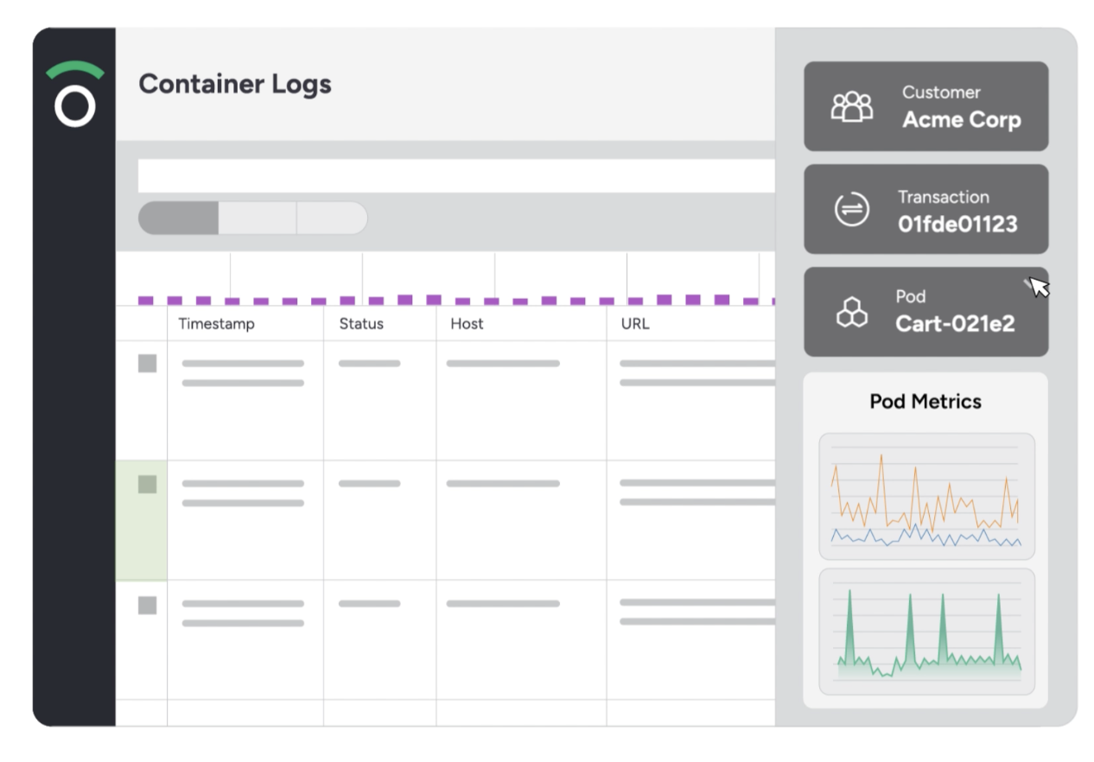


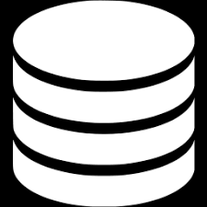
Before OTel
OTel Utopia
Many Tools
One Tool
✓ Logs
✓ Metrics
✓ Tracing
✓ Dashboards
✓ Alerts
✓ Integrations
Many Languages
One Language
</>
< >
<\>
Many Databases
One Data Lake
Logs
Metrics
Traces

Slide 22
Vendor Neutrality:
Future Proofing Your O11y Strategy

Slide 23
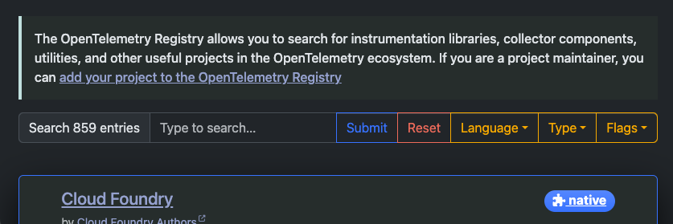

Slide 24
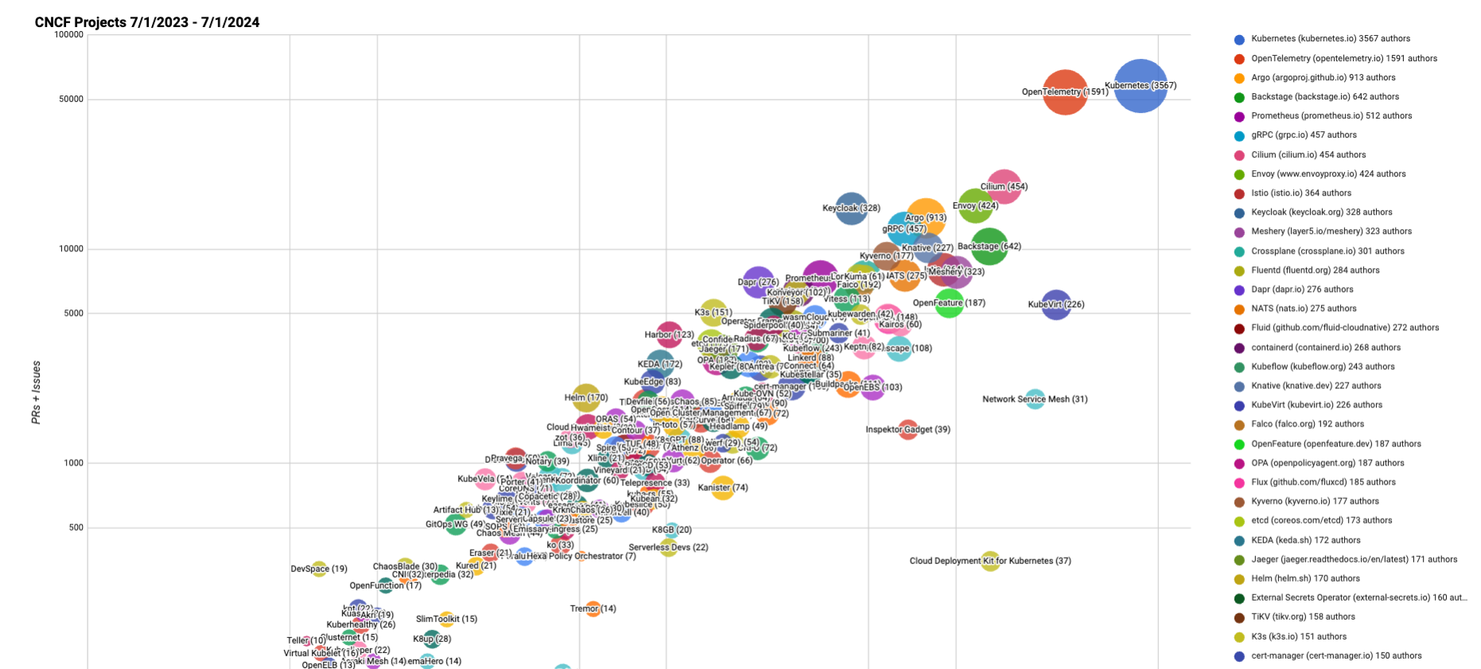

Slide 25
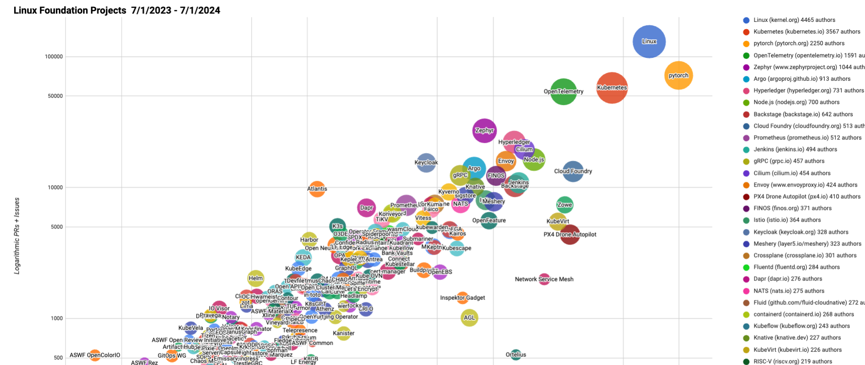

Slide 26
Ecosystem & Repositories
https://opentelemetry.io/ecosystem/distributions/
https://opentelemetry.io/ecosystem/registry/
https://github.com/open-telemetry/opentelemetry-collector-contrib/tree/main/receiver

